Slide 1
MongoDB Indexes

Slide 2
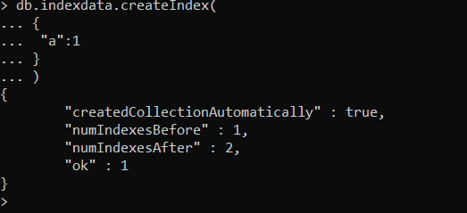
createIndex

Slide 3
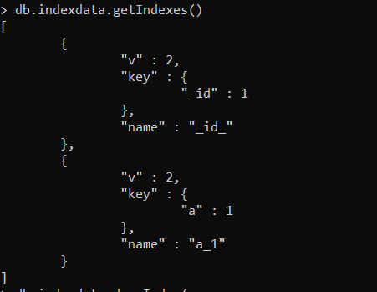
getIndex

Slide 4
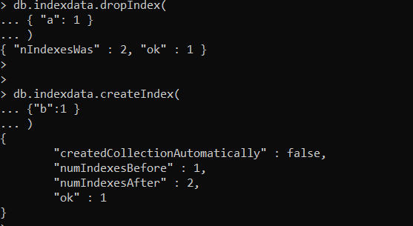
dropIndex

Slide 5
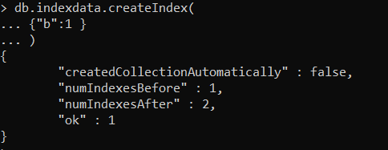
Single Index

Slide 6
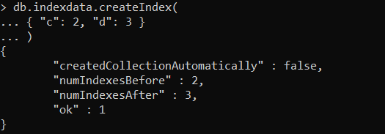
Compound Index

Slide 7

Unique Index

